Slide 1
Front End Engineering-I Project (Team 5)
Team Details:
Japneet Kaur 2210990433
Japneet Singh 2210990434
Japish Bagga 2201990432
Japtoz Singh Puri 2210990435
Faculty Coordinator: Dr. Chetna Kaushal
:
Chitkara University Institute of Engineering and Technology,
Chitkara University, Punjab

Slide 2
Table of Contents
Introduction
Problem Statement
Technical Details
Key Features
Project Highlights
Bonus Feature
Conclusion
References/Links used

Slide 3

Introduction
VOTE-OFF
Our website is designed to provide a seamless and efficient voting experience for viewers, ensuring that their votes are accurately recorded and counted.
The VOTE-OFF online voting system has transformed the way we engage with reality TV shows, offering a more convenient and interactive experience for viewers and enhancing the entertainment value of the competition.
The web page is developed using HTML, CSS and Java programming language.

Slide 4
Problem Statement
A Voting platform is designed to show the increase/ decrease in the votes of particular contestant using HTML, CSS and JavaScript.
The platform should look quite dynamic to show the progress bars of each contestants.

Slide 5
Technical Details
HTML: Defined the structure of the page, but doesn’t look very attractive.
CSS: Adds style and flair to the page.
JavaScript: Adds interactivity and dynamic content to the website.

Slide 6
Key Features
Voting system: A secure and user-friendly voting system that allows viewers to vote for their favorite contestants.
Real-time results: The website should display real-time results to keep viewers engaged and informed about the voting process.

Slide 7
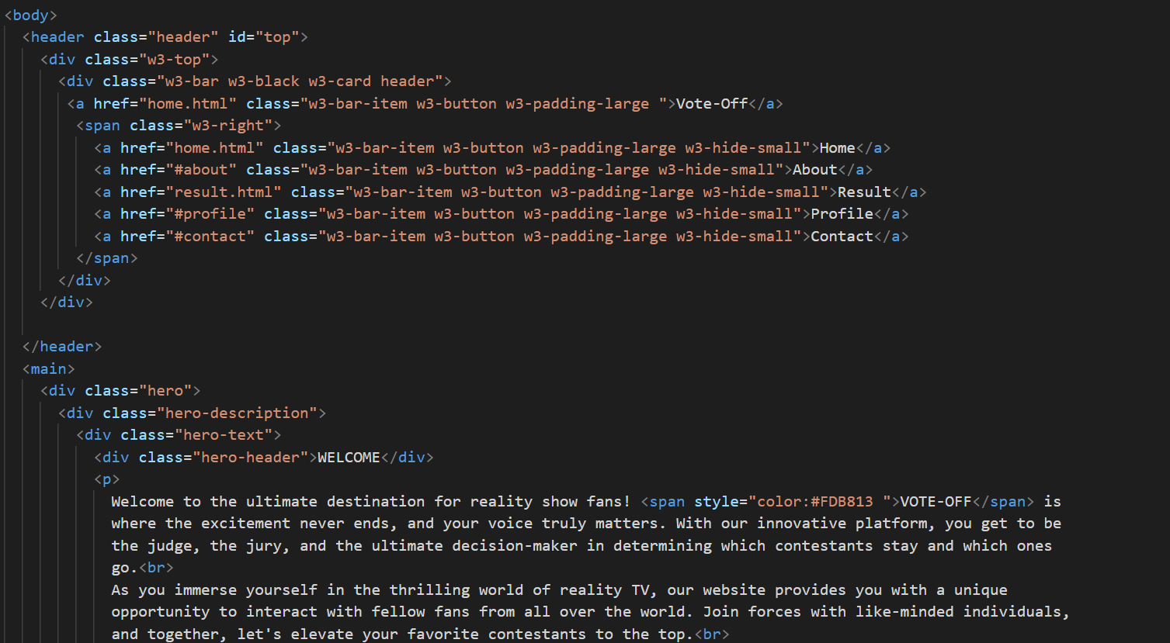
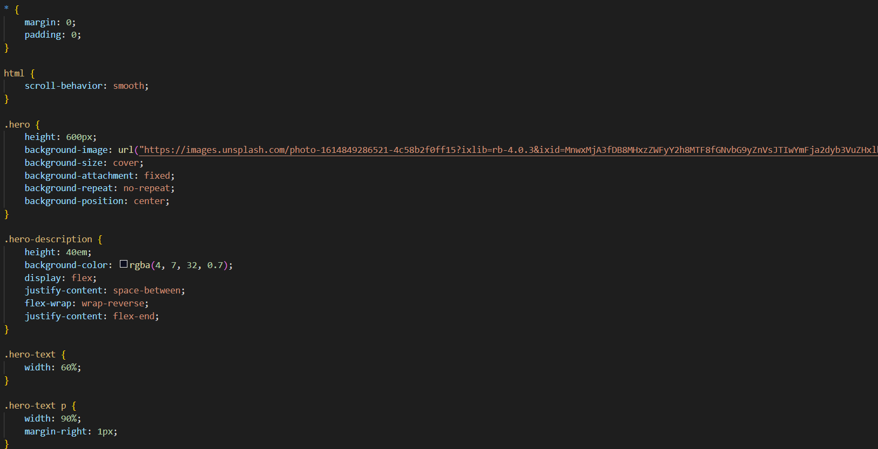
Code Snippets: Welcome Page

Slide 8
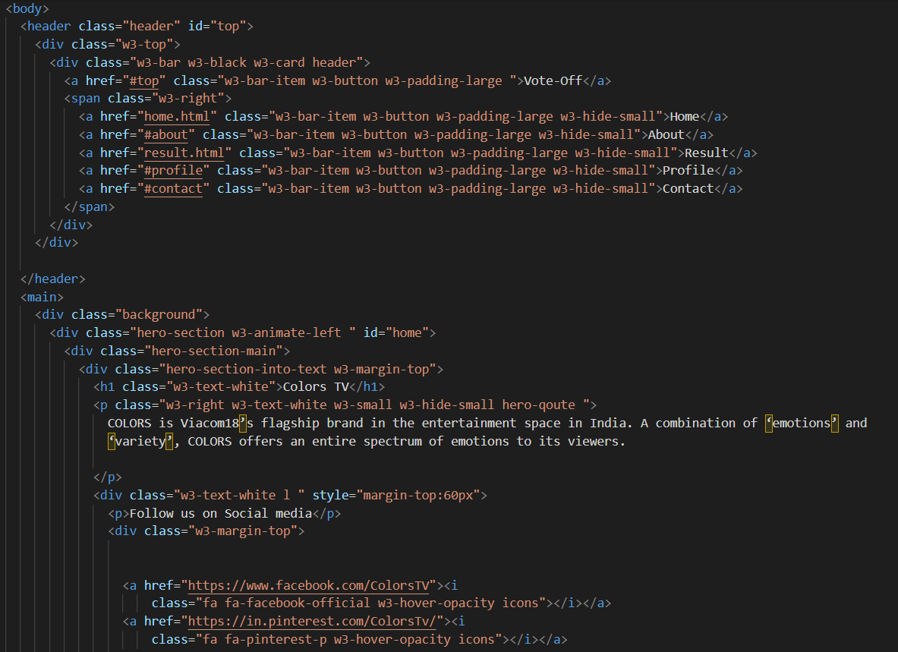
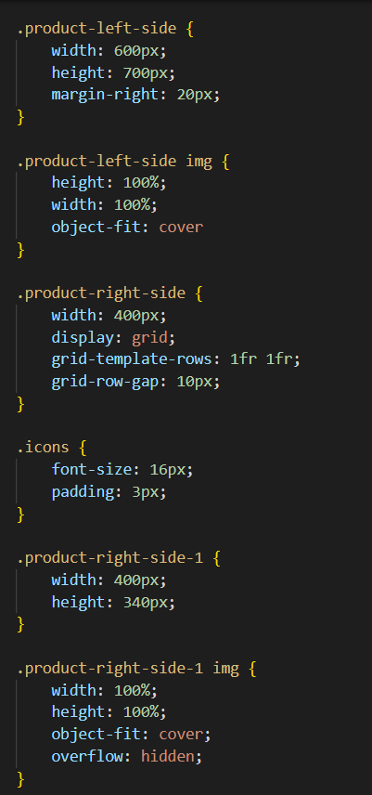
Code Snippets: Channel Page

Slide 9
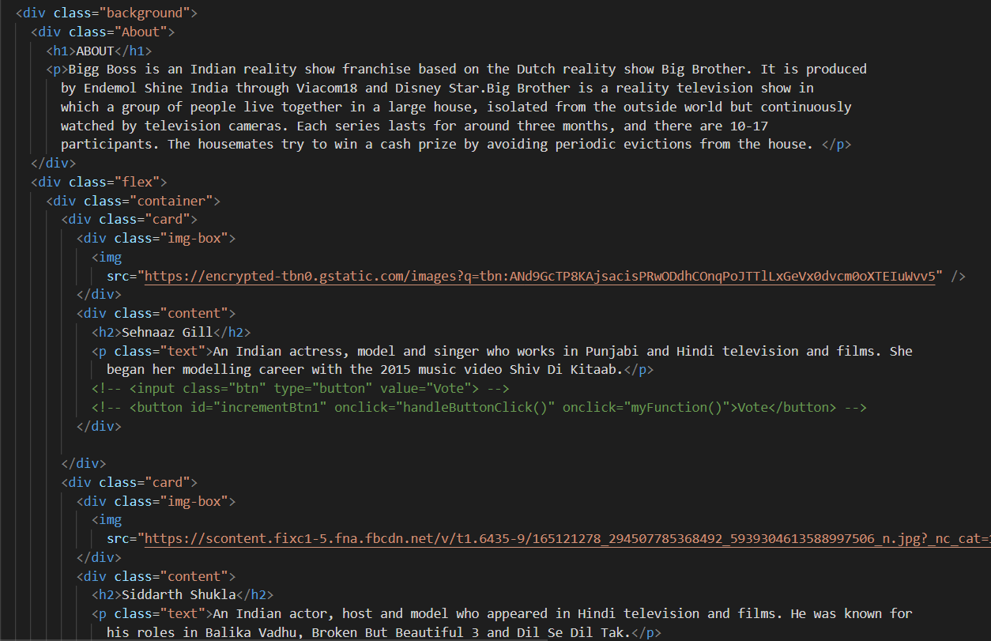
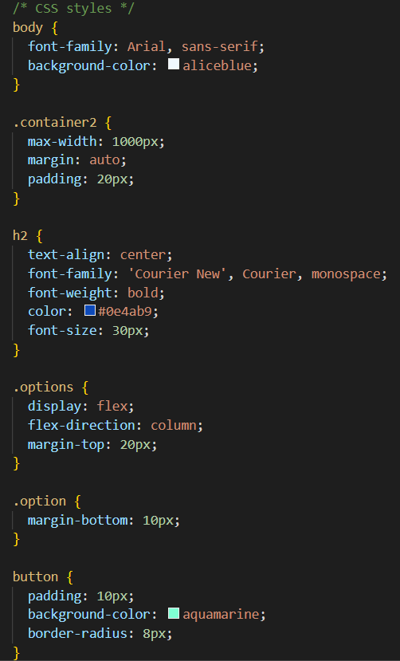
Code Snippets: Contestant and Result Page

Slide 10
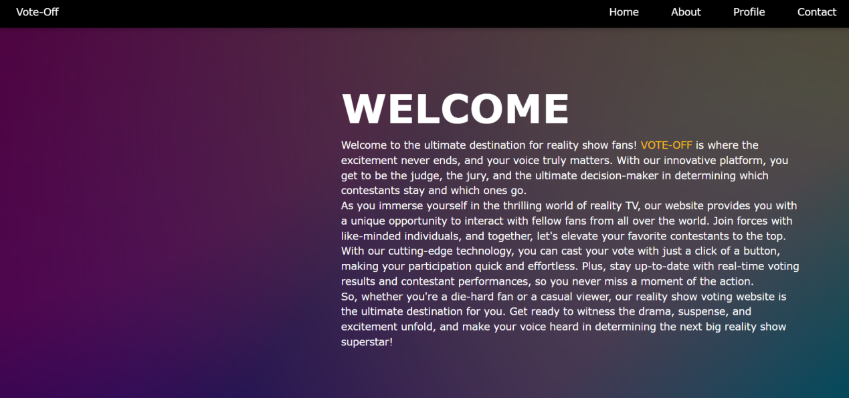
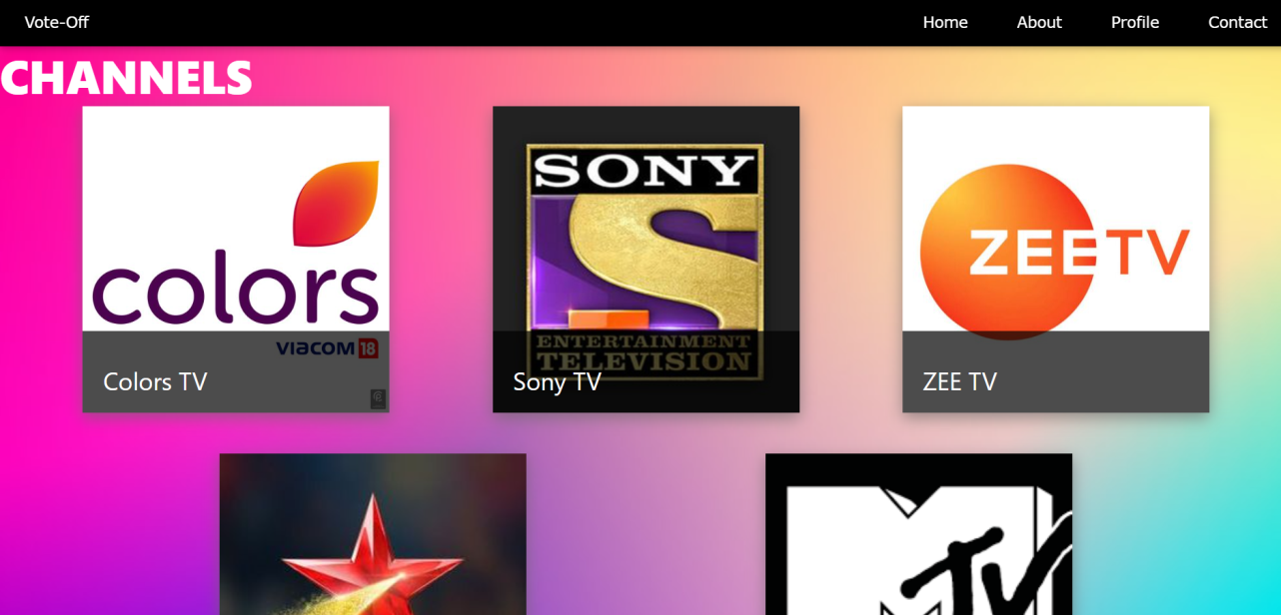
Project Highlights: Welcome Page

Slide 11
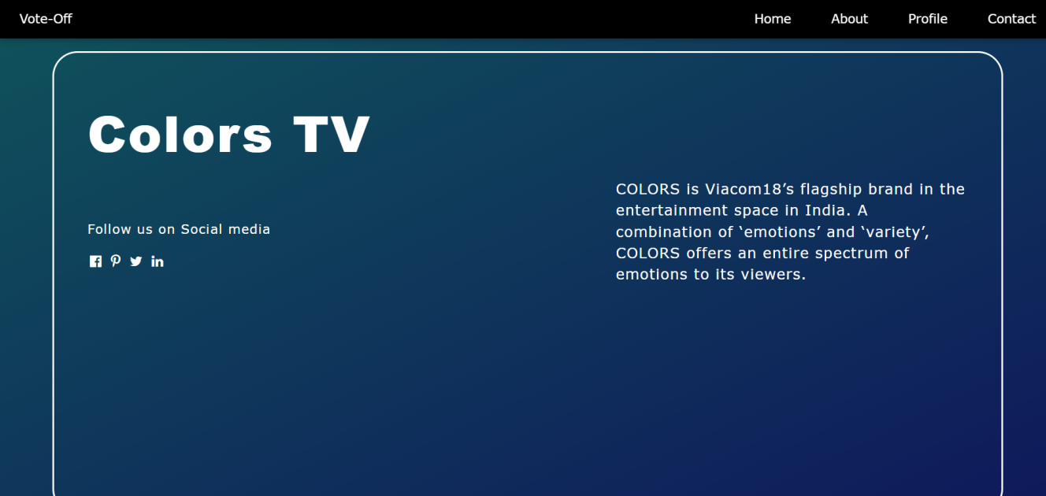
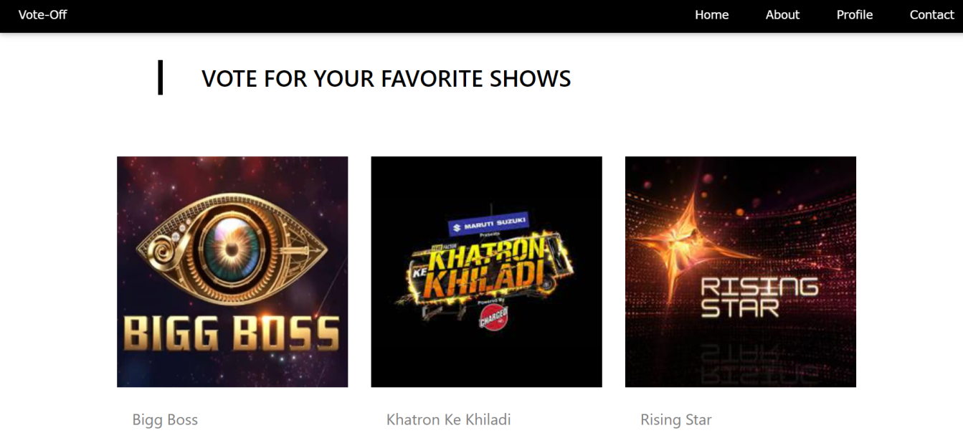
Project Highlights: Channel Page

Slide 12
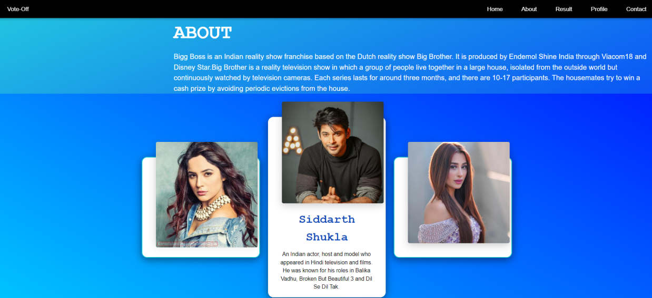
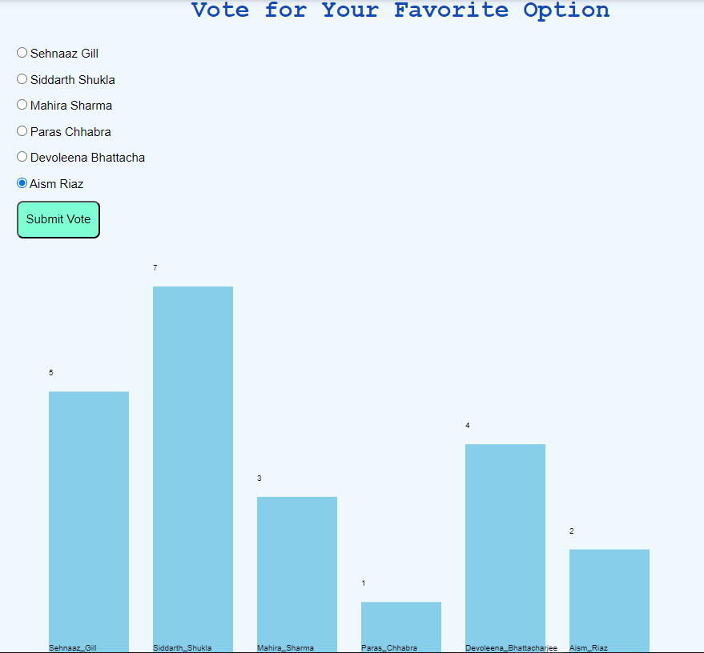
Project Highlights: Contestant and Result Page

Slide 13
Bonus Feature
Predictive analysis: Use predictive analysis to suggest the likely winner of the show based on historical voting patterns and user behavior.

Slide 14
Conclusion
The online Bigg Boss voting system project is an innovative and engaging way to promote audience participation and engagement in the reality TV show.
The advantages includes increased audience engagement, and cost-effectiveness, make it an attractive option for broadcasters and viewers alike.
Vote-Off is a user-friendly web application that allows viewers to vote for their favourite contestants in real-time.

Slide 15
References/Links used
WEBSITES:
https://codepen.io/
https://www.w3schools.com/
https://www.codeschool.co/
https://www.geeksforgeeks.org/
BOOKS:
‘Web Enabled Commercial Application Development using HTML, JavaScript, DHTML and PHP’ by Ivan Bayross, 4th Edition, BPB Publications.
‘The Complete Reference HTML & XHTML’ by Thomas Powell, 5th Edition, Tata McGraw-Hill Company Limited.

Slide 16


